Slide 1


CU Boulder Math

Slide 2
Want Print?
Subscribe to Get Everything for One Price*
When you purchase access to your Cengage digital platform through Cengage Unlimited, you can get a print rental for just $7.99 + free shipping.
OR, rather own the textbook? Cengage Unlimited subscribers can purchase the
looseleaf version at a
discounted price.
For $119.99 per term ($179.99 per year), you get:
Your digital course—plus access to all Cengage course materials for any course you're taking!
All 22K+ ebooks, online homework** and study tools in the Cengage Unlimited collection, which includes course materials for over 70 disciplines. Learn for class and for fun—your choices are limitless!
*Cengage Unlimited is not available for all WebAssign courses.
**Access to digital platforms is available when assigned by your instructor.

Slide 3
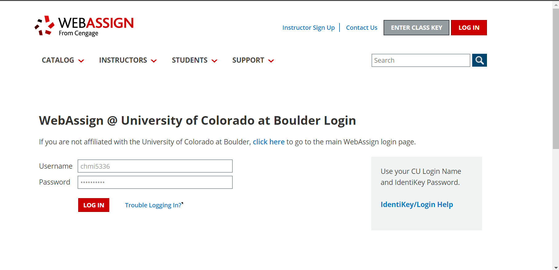
Login to WebAssign at https://www.webassign.net/colorado/login.html with your CU IdentiKey username/password

Slide 4
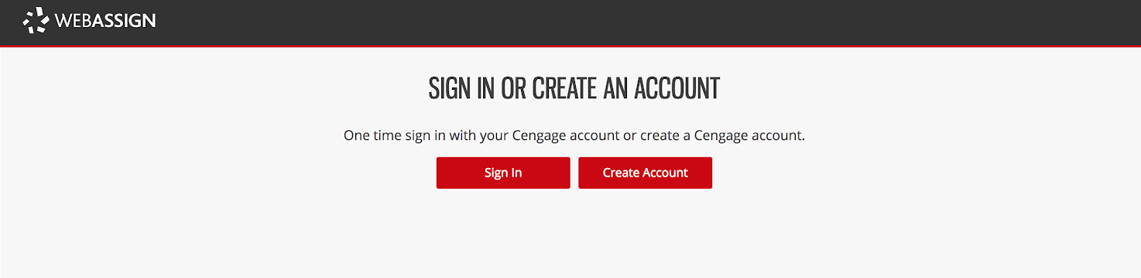
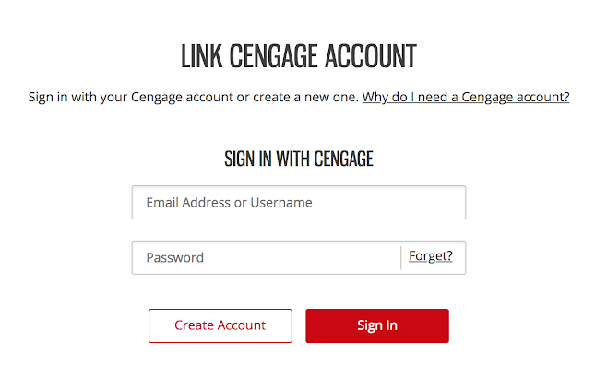
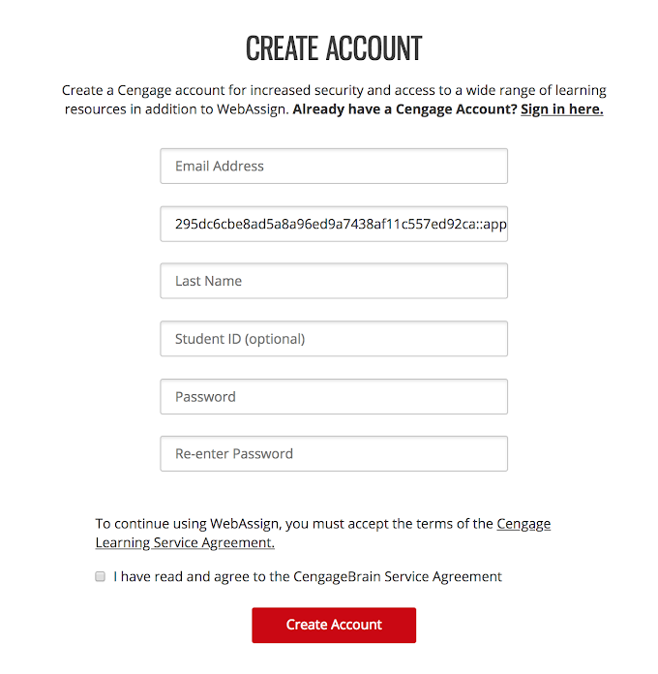
Link Your Cengage and CU IdentiKey Accounts
If you have a Cengage account, login by clicking on “Sign In”.
If you don’t have a Cengage account, you can create one by clicking on “Create Account”.
NOTE: This is a one-time process. If you have previously completed this step (e.g. for another course), you won’t have to complete it again.

Slide 5
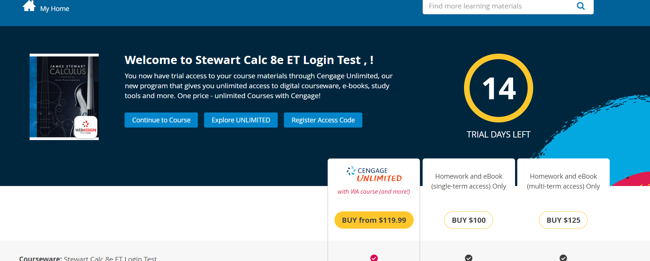
Payment Options
You can purchase access online or verify payment by entering the Access Code from your textbook.
To purchase your course materials, you can subscribe to Cengage Unlimited to gain access to your WebAssign. After you purchase Cengage Unlimited you’ll have options to rent or purchase the print text.
Already have an Access Code?
Click ‘Register Access Code' to redeem it.
Need more time to decide? Click ‘Continue to Course’ to take advantage of the 2-week grace period by jumping right into your WebAssign course.**
3
2
1
*Cengage Unlimited is not available for all WebAssign courses.
**After the grace period expires, you will need to purchase access to your WebAssign course.
Notes:
Add step 3

Slide 6
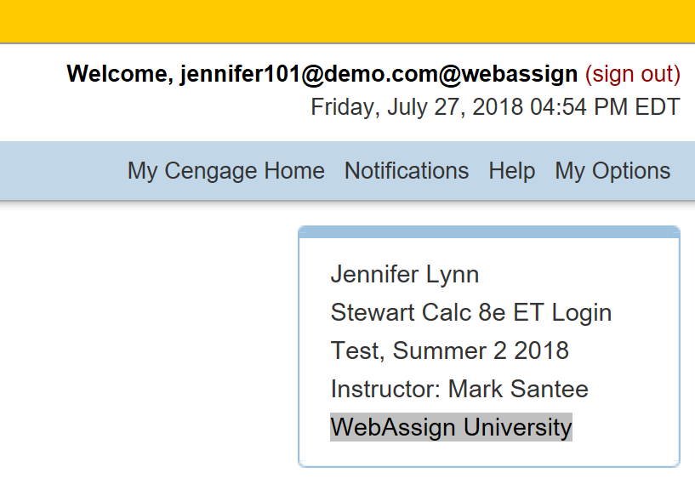
Check Out Cengage Unlimited!*
Take advantage of your 2-week free trial of Cengage Unlimited! Check it out by clicking the link to 'My Cengage Home’ within WebAssign.
Get access to your course materials, study guides and tutoring sessions
Explore thousands of subjects – whatever YOU find most fun and interesting.
Keep up to six eBooks in your digital locker for up to a year!
For courses lasting more than one term, subscribing to Cengage Unlimited guarantees you access to WebAssign for all semesters in the course sequence – regardless of the length of your Cengage Unlimited subscription!
*Cengage Unlimited is not available for all WebAssign courses.

Slide 7
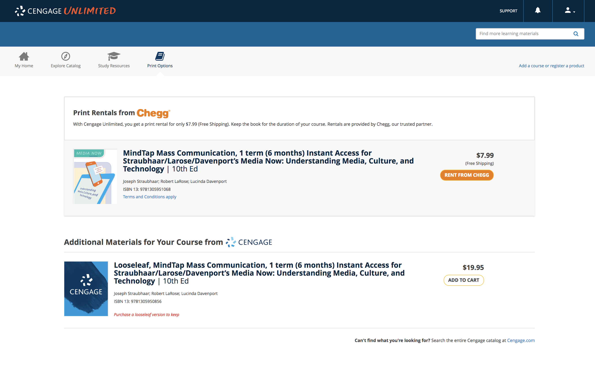









PRINT OPTIONS
WANT PRINT?
Students enrolled in a digital course (MindTap, WebAssign, etc.) who have subscribed to Cengage Unlimited are eligible to get a print rental of the assigned textbook for just $7.99 + free shipping.
They can keep the textbook rental for the entire duration of their Cengage Unlimited subscription!
OR, rather own the textbook? Cengage Unlimited subscribers can purchase the looseleaf version at a discounted price.

Slide 8

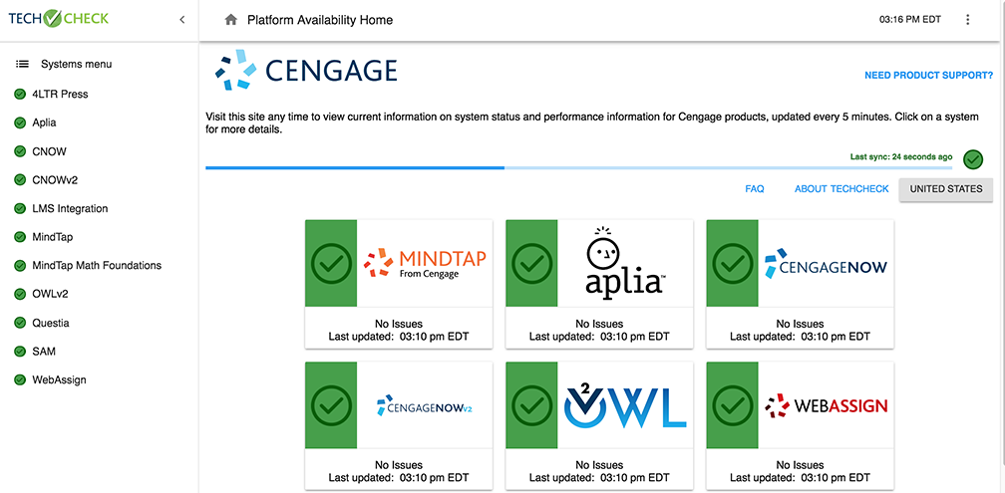
Have Questions? We’re Here to Help!
Techcheck
We’re Here 24/7
Get Real-Time System Status!
Techcheck.cengage.com provides immediate insight into system performance, so you can quickly see if Cengage is experiencing technical difficulties.
Call Us Anytime
1-800-354-9706
Chat Support and Online Self-Help
Visit cengage.com/support to get started!

